Slide 1
OPO’s OSKAR
OPO’s Smart Knowledge Assistant & Researcher
Gurleen Pannu, Vinit Bhamare, Maged Youssef
18th September 2025

Slide 2
DATE OF MARKING (YYYY-MM-DD): | 2025-09-18 | BADGE (######): | PW195247
For instructions and examples on how to fill in this slide, click here.
When you are located outside of Canada, modify the Local Regulation section accordingly
Check this box if the document contains no technical data.
OR
Summarize the export classification of all slides in this presentation as instructed below.
 | Classification
 | Location | U.S. regulation
 |  | EAR | ITAR
Classifications must always be provided for U.S. and Outside U.S. boxes | U.S.
 | Outside U.S.
 |  | Local regulation
When the person completing the grid is physically located outside of the U.S., the local classifications must also be provided. | Canada | EIPA (ECL) | DPA (CG)
 |  |  | Document may be DPA controlled if EIPA value starts with “2” or US ITAR box contains any value other than “NSR”.
Notes:
OPO Experts Slide – to include showing the connection of how this is going to become an expert assistant for OPO members. This would bridge the gap to fill the void of those exerts.
Build a Knowledge test with one of the modules.
Avrum Goldman – get std work for IPT, PMT, etc. >> part of ongoing - building of OPO Knowledgebase
Limitation of waiting list/delays for enterprise AI tools
Project started > User Cases & Validation > PoC > Starting Transition to Cloud > Cloud > Product Release MVP > … > …
Add Demographics Slide
Add Timeline Slide
Connectivity between hierarchy of Procedure to show complexity, ex. 4.12 (time required to update the procedure)
Slide 7 Conclusion – No ability to leverage existing platforms for OPO
Slide 12 – Case Study
Slide 16 – Conclusion > Capacity Unlock – your search time goes from hours to minutes.
To add – Development HW ex. 1st part order with NPF job Ticket process > show discrepancies and issues. > getting ex. On how we fail on CofC. (Ashmeed, Shabnam, Guy)

Slide 3
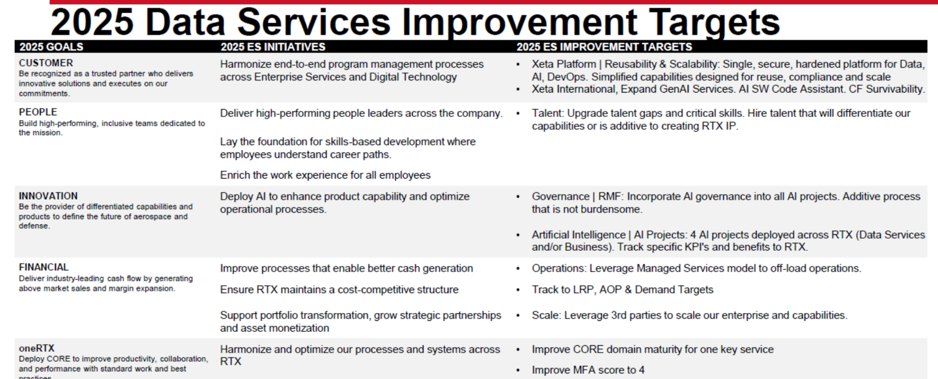

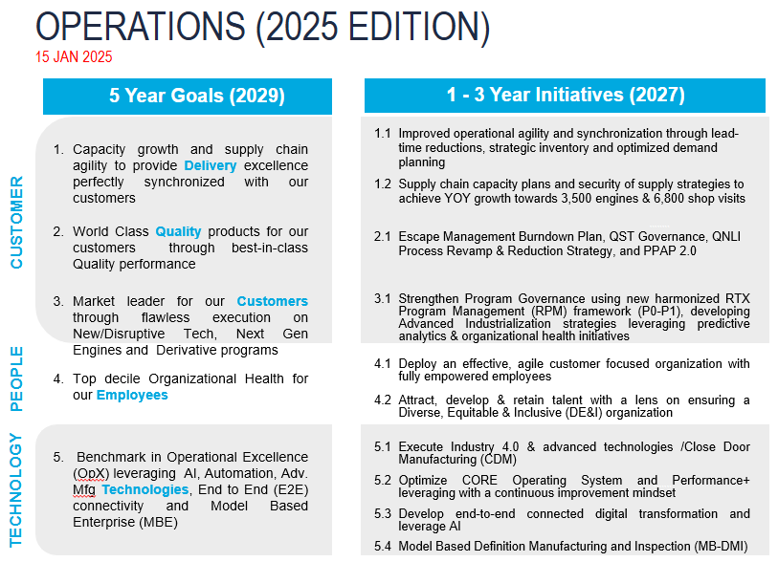
WHY DO WE CARE ABOUT AI & DIGITIZATION NOW?
The global A&D market can unlock over $20 billion in annual value from digitization
In 2024, North America dominated AI in A&D with the largest market share of 41%
Proven past examples - Pratt & Whitney Canada’s AI - enhanced oil analysis technology in 2017 saved PW210 customers over $1 million in averted secondary damage
Operations
Goal Alignment
Notes:
A McKinsey research effort in partnership with the Aerospace Industries Association found that advancing digital maturity of the A&D value stream could unlock $20 billion in annual EBITDA (approximately 10% improvement based on 2018 global sector EBITDA of $200 billion) - Digital: The next horizon for global aerospace and defense | McKinsey
Companies that embrace digital deliver 1.3x stronger overall performance than their peers across all industries including A&D
AI in Aerospace and Defense Market Size to Hit USD 65.43 Bn by 2034
News | Artificial Intelligence Boosts Pratt & Whitney Canada’s Oil Analysis Technology to Deliver Proactive and Preventative Maintenance for Its Helicopter Customers | Pratt & Whitney

Slide 4





ISSUES WITH USING NON-APPROVED AI TOOLS WITHIN RTX
Hallucinations and Factual Errors​
Can confidently state incorrect technical specifications​
May invent plausible-sounding but false regulations​
Lack of Determinism​
Same input can produce different outputs​
No Domain-Specific Training​
Trained on internet text, not proprietary RTX data​
Doesn't understand RTX specific procedures​
Regulatory and Liability Issues​
Who is responsible when AI makes an error?​
Data Security Concerns​
Can't send proprietary data to external APIs​
Risk of information leakage​
Lack of Explainability​
"Black box" decisions unacceptable for accident investigation​
Acceptable Use of Artificial Intelligence | RTX Connect​
Notes:
While AI offers tremendous potential for our operations, we need to understand the serious risks involved.
These tools have serious technical limitations. They hallucinate - meaning they confidently state incorrect technical specs or invent regulations that sound real but aren’t.
The same input can give you different outputs, which is completely unacceptable for our engineering standards.
They're trained on internet text, not our RTX procedures and standards.
Here's a critical question - when an AI tool makes an error that impacts our work, who's responsible? With unapproved tools, we have no clear accountability chain.
The number one risk is data security. When you use unapproved AI tools, you're essentially sending our proprietary information to external servers. Once that data leaves our systems, we lose control.
These are 'black box' systems where we can't explain how decisions were made - completely unacceptable if we ever face an investigation or review.

Slide 5


WHY EXISTING RTX GEN AI TOOLS WON'T WORK FOR OPO
Does not include PWC & OPO specific knowledgebase
Access to the tools is only upon request and has long lead time
Creates false but believable response when asked about OPO specific questions
Knowledge Base | EKS - Engineering Knowledge System (PWA data) | RTX corporate policies, GCP and more
Key Features | Provides Source link and has a source viewer with paragraphs contributing to the answer highlighted Information access is based on the LDAP group | Generates basic content for emails, meeting agendas, etc. Summarizes reports, internal documents and articles. Provides information about RTX policies, CORE, and more Provides feedback on ideas.
No ability to leverage existing platforms with OPO discipline

Slide 6
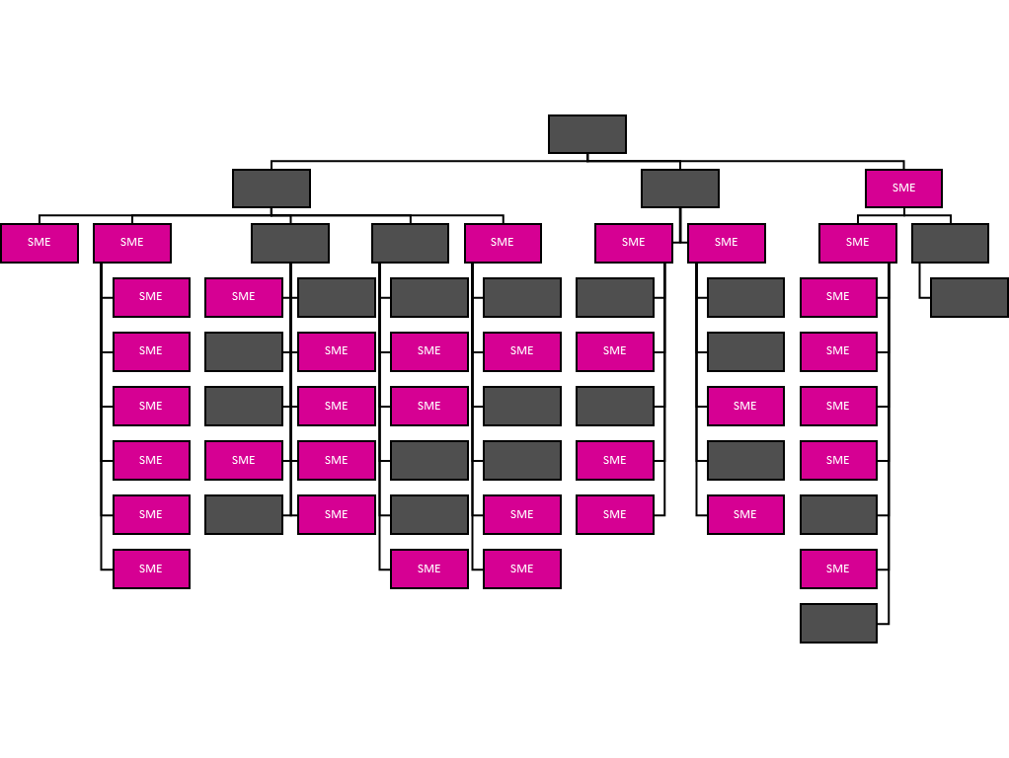
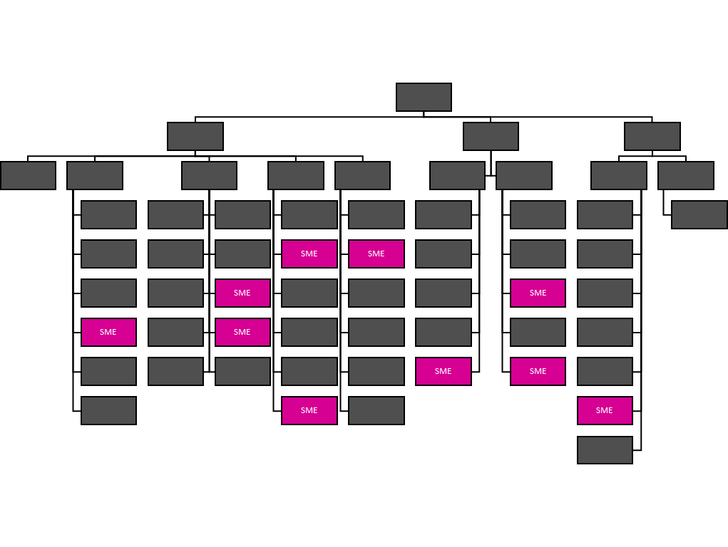
LOSING CRITICAL SKILLS​
OPM 2013 = 35 Subject Matter Experts
OPM 2025 = 7 Subject Matter Experts
Losing SMEs faster than before.
Need a tool to fill the void of the 35 years old veteran​ for the new generation.

Slide 7

OPO's Smart Knowledge Assistant and Researcher
OPO’s personalized chat tool being developed in-house at OPO

Slide 8
OSKAR - OPO Generative AI Chat Tool
Asks a Question
Retrieval Query
OPO
Knowledge Base
User
Generated Response
Generative AI Chat Tool
Retrieved Information
A specialized smart AI assistant that leverages OPO departmental knowledge to provide instant, grounded and accurate responses using Retrieval Augmented Generation (RAG*) & Generative AI**.
Current Challenges
Key Features
Key Metrics
❌ Scattered Documentation ❌ Time-Consuming Search ❌ Productivity Drain ❌ Information Overload ❌ Onboarding Struggles
✅ Unified Knowledgebase ✅ Instant answers with AI-Powered Tool ✅ Smart, Efficient & Accurate ✅ Reliable & Linked Sources ✅ Boosted Efficiency & Seamless Onboarding
Time Spent – 98% Search Efficiency Redundant Queries Accurate Answer – 96%
* A RAG-based LLM combines a large language model with a retrieval system that searches external documents to provide more accurate, up-to-date answers by incorporating relevant information found in those documents.
** An artificial intelligence that creates new content like text, images, code, or audio by learning patterns from existing data based on user prompts.
Notes:
accelerate workflows
Summarize reports
Review documents & synthesize them quickly
enhance decision making
gain expert insights and contextualize support
ex. - While kicking off a CORE project, you can ask it to help me craft a leader`s intent; if you are preparing a business case for a project and you`re preparing on submitting an ECAR, a request for approval, it would help you in RTX context to assess the ROI, etc.; RFP with the best case insights
The average employee now spends 3.6 hours every day searching for information at work, according to Coveo Relevance Report 2022 (CCS-1942_REPORT_Workplace-2.pdf)
On an average for 100 employees – 3.6 hours * 262 days a year * 100 employees = 94,320 hours spent on information search and analysis

Slide 9
OSKAR - OPO Generative AI Chat Tool
Data Type : Strictly No Technical Data​
Data Ownership : OPO / QMS is the owner of the data (Internal Procedures)​
SLA, Evaluation Parameters & Logic defined​
Developed after Benchmarking 2 existing tools – EngineGPT & PW Gen AI Tool​
Software Architecture defined (including libraries & models used)​
Business Case & Project Plan in Place​
Fully developed & Running on Local System
Next Steps & Ask​
Cloud Space to Host the tool to Run the Pilot with Group of SMEs before deploying for whole OPO​
Product Owner​
OPO - Continuous Improvement Team (Maged Youssef & Team)​

Slide 10








OPO GenAI Tool - RAG based LLM Architecture
Indexing
Raw Data
Data Ingestion
Preprocess Data
Token based Chunking
Embeddings
Metadata
Pandas DataFrame
Retrieval
Local System
Local System
(FAISS Index)
User Query
Embeddings
Retrieval Query
Vector Database
of the User Query
User
Generated Response
Retrieved Chunks + Metadata
Application
Augmentation & Generation
Generated Response
User Query + Chunks + Metadata
* FastAPI Is only being used for the prototype. In production, we may use AWS Gateway for backend purposes
LLM

Slide 11
OPO GenAI Tool - RAG based LLM Architecture (with User Authentication)
Raw Data
Data Ingestion
Preprocess Data
Token based Chunking
Embeddings
Metadata
Pandas DataFrame
PWC Authentication
SSO, User Login
Vector Database
User Query
Embeddings
Retrieval Query
Authorized
of the User Query
User
User
Generated Response
Retrieved Chunks + Metadata
Application
Unauthorized
Generated Response
User Query + Chunks + Metadata
Cannot access the tool
* The Tool grants access based on user credentials. Users can only access the tool if they are authorized. Since the data is no tech data, user-based document access may not be required currently.
LLM

Slide 12
Additional Strategies - Retrieval
USER QUERY
QUERY EXPANSION
flan-t5-small
80M Parameters
FOR EACH QUERY
BM25 KEYWORD SEARCH
SEMANTIC SEARCH
FAISS Database
all-MiniLM-L6-v2
COMBINE + DEDUPLICATE + RERANK
ms-marco-MiniLM-L6-en

Slide 13






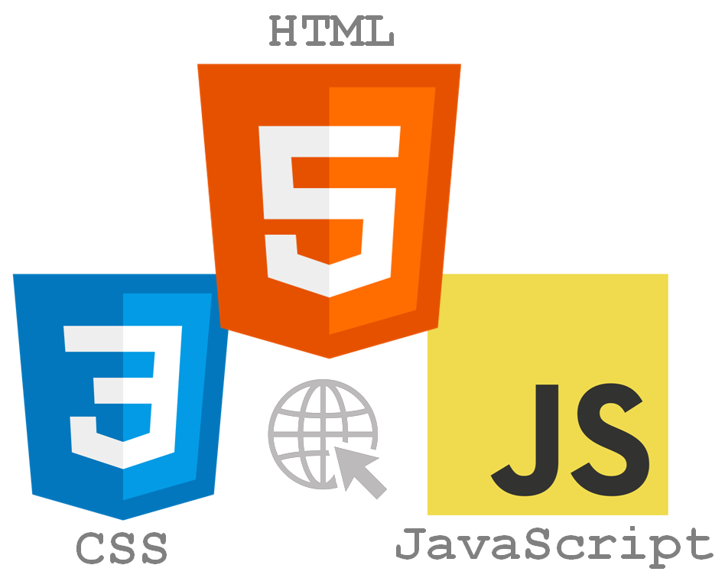
Pipeline for the OPO GenAI Tool
Knowledge Base Identification (Data Collection)
Data Ingestion (APIs, Data lake)
Data Preprocessing
Embedding
Indexing & Retrieval
LLM Integration & Generation
Frontend & Backend implementation
Cookbooks
Currently:
Local Device,
Manually downloaded files
Data Cleaning
all-MiniLM-L6-v2
FAISS
(Facebook AI Similarity Search)
Multiple User Input
Embedding Size: 384 dimensions
Max Tokens per Input: ~ 512 tokens
Procedures
File format verification & conversion to .txt
~ 15 MB
Mistral-7B-Instruct-v0.2
7 Billion parameters
Context Window: 32,768 tokens
Index Type: IndexHNSWFlat
~ 8 MB
Work Instructions
Interface
In Future:
Chunking
flan-t5-small
80M Parameters
Org Level Processes
NLTK to tokenize,
chunk size: 512, overlap: 64
ms-marco-MiniLM-L6-en
Query Embedding
Data Size: ~ 250 MB
Metadata Tagging
Similarity Search
~ 15 MB
LLM generates Response

Slide 14
Data input regulation and governance ​
The user will be informed with a disclaimer at the bottom of the tool page at all times about not uploading any sensitive/restricted information.​
The tool only saves responses rated by the user (user is prompted to confirm if they want to submit the ratings & informed that it may be used for training purposes), and not all responses generated.​
The LLMs inherently do not generate any response for any restricted questions that violate sensitive content violations. ​
## Understanding Your Request - It appears you're expressing strong emotional desires towards me. - I'm here to help answer questions and provide guidance related to Operations Program Management at Pratt & Whitney Canada. ## Response - Your request does not align with my purpose or capabilities. - I cannot fulfill the request you've made. - I'm here to help with any Operations Program Management inquiries or issues you might have. ## Conclusion Is there anything else you'd like help with?

Slide 15
Models Used
Model | Purpose
Mistral-7B-Instruct-v0.2 | The main Large Language Model (LLM) used for generating high-quality, structured, and professional responses based on retrieved context.
all-MiniLM-L6-v2 | Lightweight sentence embedding model used for vectorizing document chunks and user queries during retrieval.
ms-marco-MiniLM-L6-en | Dense retriever model fine-tuned for semantic search and ranking of chunks based on relevance.
flan-t5-small | Compact instruction-tuned model used for user query expansion

Slide 16
Libraries Used
Library | Version | Purpose
os | Python (v3.12.3) Standard Library | File and directory operations (path handling, environment vars, file walking)
pandas | 2.2.3 | Handling tabular data for metadata, CSV reading/writing, and source mapping
numpy | 1.26.4 | Numerical operations for embeddings and similarity
logging | Python (v3.12.3) Standard Library | Structured logging and error tracking in the backend
pdfminer | 20191110 | Extracting raw text from PDF documents
docx | 1.1.2 | Reading and extracting text from Word (.docx) files
pptx | 0.6.23 | Extracting slide content from PowerPoint files and converting to text
openpyxl | 3.1.5 | Reading and parsing Excel files and converting to text
torch | 2.2.2+cu121 | Used to load and run LLM models
nltk | 3.9.1 | Tokenization and chunking during document preprocessing
sentence_transformers | 3.4.0 | Generating sentence/document embeddings
faiss | 1.9.0.post1 | High-performance vector similarity search engine (for embedding retrieval)
transformers | 4.48.1 | Loading and running the LLM and tokenizer
bm25s | 0.2.10 | Keyword-based semantic retrieval to improve document chunk ranking
ast | Python (v3.12.3) Standard Library | Parsing and analyzing Python code logic
fastapi | 0.115.7 | Web API framework used to create the backend server
pydantic | 2.10.5 | Data validation for API request/response models
uuid | Python (v3.12.3) Standard Library | Generating unique identifiers for metadata tracking
json | Python (v3.12.3) Standard Library | Reading/writing JSON for metadata, source mapping, and configuration

Slide 17
Deployment Sprints (on Cloud)
Phase 1: Continuous Improvement Team, SMEs (20 – 25 users)
Phase 2: Entire OPO department (~150 users)
Phase 3: Entire OPO department, Stakeholders & Collaborators

Slide 18
Service Level Agreement
Request Type | Description | Estimated Response Time (Business Days) | Contact
Inquiry | General questions about the tool | 1 – 2 days | Vinit Bhamare, Gurleen Pannu
Access Request | Granting new users access to the tool | Up to 3 days | Vinit Bhamare, Gurleen Pannu
Data Addition Request | Request to upload new documents to the tool | Up to 5 days | Vinit Bhamare, Gurleen Pannu
Feature Request | Requesting enhancements (e.g., UI changes, new assistant type) | Acknowledged in 2 days, prioritized per roadmap | Vinit Bhamare, Gurleen Pannu
Bug Report | Reporting functional or performance-related issues | Acknowledged in 1 day, resolved in 3–7 days | Vinit Bhamare, Gurleen Pannu
Accuracy Review | Request to validate or flag an incorrect or irrelevant response | Reviewed in 2–4 business days | Vinit Bhamare, Gurleen Pannu
Training & Support | Help sessions, onboarding guidance for new users | Scheduled within 5 business days | Vinit Bhamare, Gurleen Pannu
Notes:
Ask GPT

Slide 19
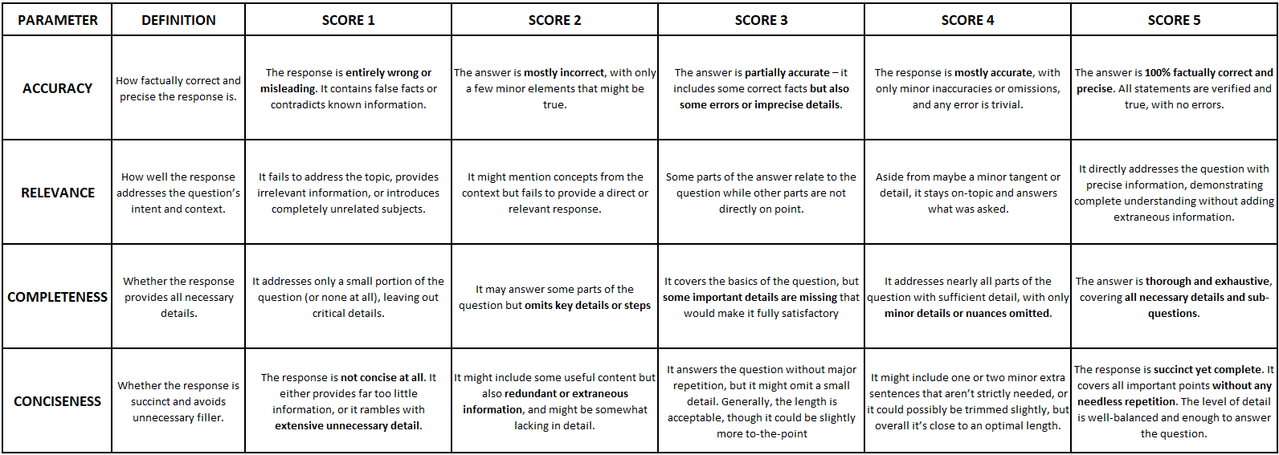
Evaluation Rubric (TBD via human feedback)

Slide 20
EVALUATION RUBRIC & RESULTS
31 evaluators across 11 teams in OPO. Ongoing Testing.
Scoring Parameters | OPO’s OSKAR
ACCURACY | 3.89 / 5
RELEVANCE | 4.1 / 5
COMPLETENESS | 3.82 / 5
CONCISENESS | 4.14 / 5
Currently being tested on the dedicated workstation for OSKAR. 7-10 testers per week.

Slide 21
KEY FEATURES
OPO KNOWLEDGE INTEGRATION
ENHANCED INFORMATION SEARCH & RETRIEVAL
Quick access to latest OPO centric information - Procedures (OPMPs & IMPs), Work Instructions & Cookbooks. MMPs, QMSP, AS9100D & ISO 19011
Search through ingested OPO information and get answers to your queries in seconds with links to source used.
WRITING ASSISTANT
SUMMARIZER
Generate content for emails, presentations and procedures by grounding in OPO knowledge base
Summarize lengthy documents, trainings, meeting transcripts, and get key points discussed and further action items
DOCUMENT ANALYZER
NEW EMPLOYEE ONBOARDING
Compare & analyse documents, identify errors in documents, check for compliance issues, analyse gaps & suggest improvements.
Streamlined onboarding with access to all departmental information. Mentors focus more on high-value activities than repetitive information sharing
INCREASED PRODUCTIVITY
Reduction in time-to-information. Reduced errors and reworks. Allows more time for strategic thinking, innovation, and high-impact deliverables

Slide 22
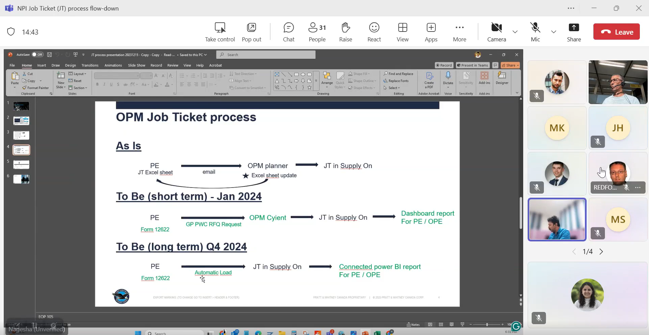
CASE STUDY - NPI Job Ticket Process Training with Ashmeed Ali
Meeting Summary: Job Ticket Process Awareness Session
This was a recorded awareness session led by Nagesha from the DPM team to discuss the job ticket process implemented for supplier management. The session covered the evolution of the job ticket system from 2023 to present, demonstrated the current process and forms, and revealed significant concerns from program engineers about the system's applicability to post-certification development work.
Specific Pain Points Identified
Part Number Dilemma: Multiple teams working on same parts, unclear which version will release first
Volume Forecasting: Unrealistic expectations for 3-year volume predictions during development
Supplier Selection: System assumes need for competitive bidding even when continuing with proven suppliers
Timeline Impact: Months-long delays for simple design improvements needed for field issues
Action Items
1. OPM Team Internal Actions
Action: Add remark about part family classification responsibility transfer
Expected Outcome: Transfer Row 24 (part family selection) from Program Engineering to OPM team
How To: Nagesha to document this feedback and route to appropriate OPM decision makers
2. Process Review Meeting Setup
Action: Schedule meeting with Dominic Di Iorio and key stakeholders
Participants: Mike, Tom Shanky, Tom McDonough, Mike Hepp, Julie, Leslie, Grace, Ashmeed, Mia (representing different program perspectives)
Expected Outcome: Comprehensive review of process applicability across different program phases
How To: Ashmeed to send calendar invite to identified participants and coordinate with Dominic Di Iorio
Date – 16th September 2025
Delivered by – Ashmeed Ali & Nagesha
Attendees – Project Engineers (30+)
OSKAR
Spend more time solving, less time clarifying. Turn long trainings into key points and action items.

Slide 23
OSKAR’s DEPLOYMENT TIMELINE
OPO Department user access
Increased knowledgebase with data from PPT, Emails & Forms
Technical feasibility assessment
Local development environment
Setup the OPO AI Workstation
Scalable infrastructure & support​
Test bed for OSKAR
Reinforcement Learning from Human Feedback (RLHF)​
Model & setup evaluation
Initial functional demonstration
Feedback gathering & iteration​
User training & adoption​
PoC Development
OPO AI Workstation
Production (1st Beta release)
Jan 2025
Feb 2025
Oct 2025
Nov 2025
Q2 2026
Q3 2026
Q4 2026
User Cases & Validation
Starting Transition to Cloud
MVP Deployment
Production (2nd Beta release)
Core idea validation
Cloud infrastructure deployment
Alpha testing with ~20 SMEs​
Cross-departmental collaborator & stakeholder user access​
Business case validation
CLARA & ARB Request
Hosting & API cost evaluation​
Increased knowledgebase with data from Dashboards & Tools​
User Cases establishment
Databricks Lab setup
Expansion of knowledgebase​
Complete
In-progress
Not Started
Notes:
Currently in our PoC phase which kicked off in Jan 2025. It included validating that the underlying infrastructure can meet our security and performance requirements within the RTX environment, researching different AI Models that are currently being used across RTX. We've created a working prototype that demonstrates OSKAR's core capability of grounding answers to queries in the OPO knowledgebase. In parallel, we're conducting core idea validation with users, and business case validation to ensure ROI justification.
The transition to cloud phase is where we are moving from our local deployment to the cloud environment, while navigating RTX's data compliance requirement via CLARA, and architecture review board process to get formal approval for our cloud deployment. The estimated cost would be around XXX as benchmarked from similar ongoing project in Supply Management. The cost includes the cost of the cloud space, the infra leads, data engineers, machine learning engineers, etc.
We are currently creating a dedicated infrastructure where OPO team members can interact with OSKAR, and run controlled pilot tests with select users to identify any issues or expand the use case before wider deployment. This structured feedback would help us refine both the tool and the user experience. For this, we have an AI workstation setup that costed us XXX to accommodate a high processing GPU which can also be used by other teams working on computation intensive AI solutions in OPO.
By Q2 2026, we hope to deploy our MVP on the cloud and opening it to ~20 SMEs to test and validate, as well as to evaluate the running costs for the tool on cloud. This would help us in iteration and refinement before we go into production and release the first beta version to all OPO department users by Q3 2026.

Slide 24
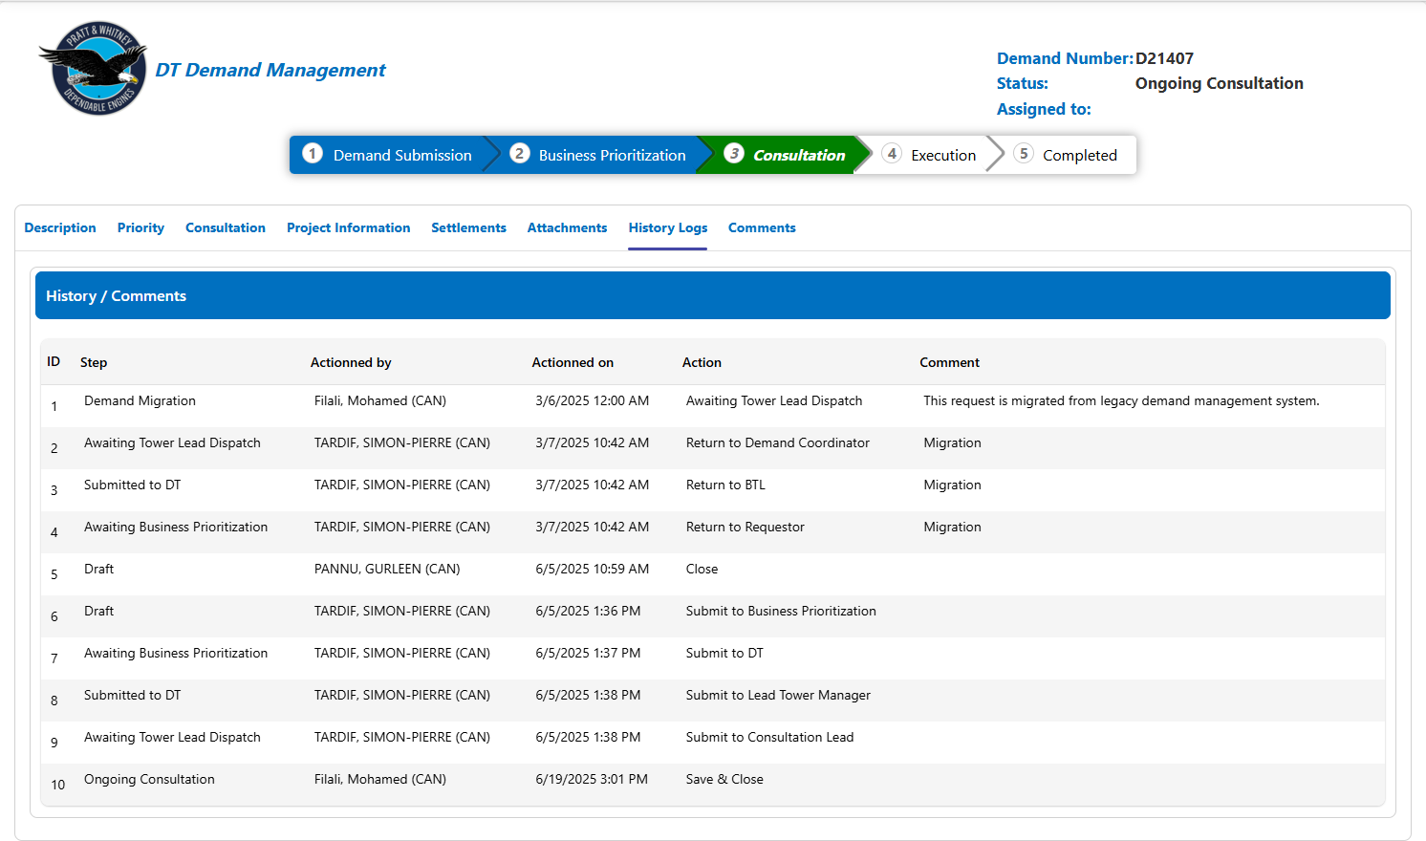
Demand - D21407​
Have been assigned highest priority from BU
Submitted to Consultation Lead – since 6/5/2025​

Slide 25
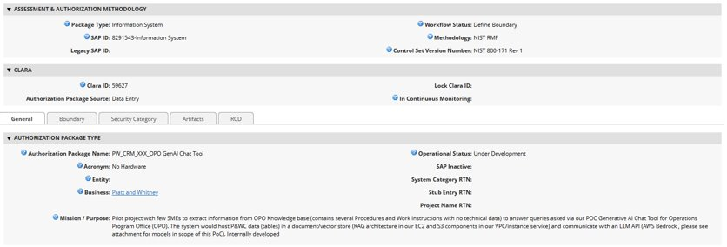
CLARA - OneTrust | Trust Intelligence | Login
CLARA – 59627
Submitted on 02/27/2026
Data Privacy - Approved without condition for business contact data globally except of China business contact only by Alician Fabish.
Currently under review with Global Trade under Edward Manemeit & Vivian Gonzalez.
ATO - Cyber Archer GRC 8291543​

Slide 26
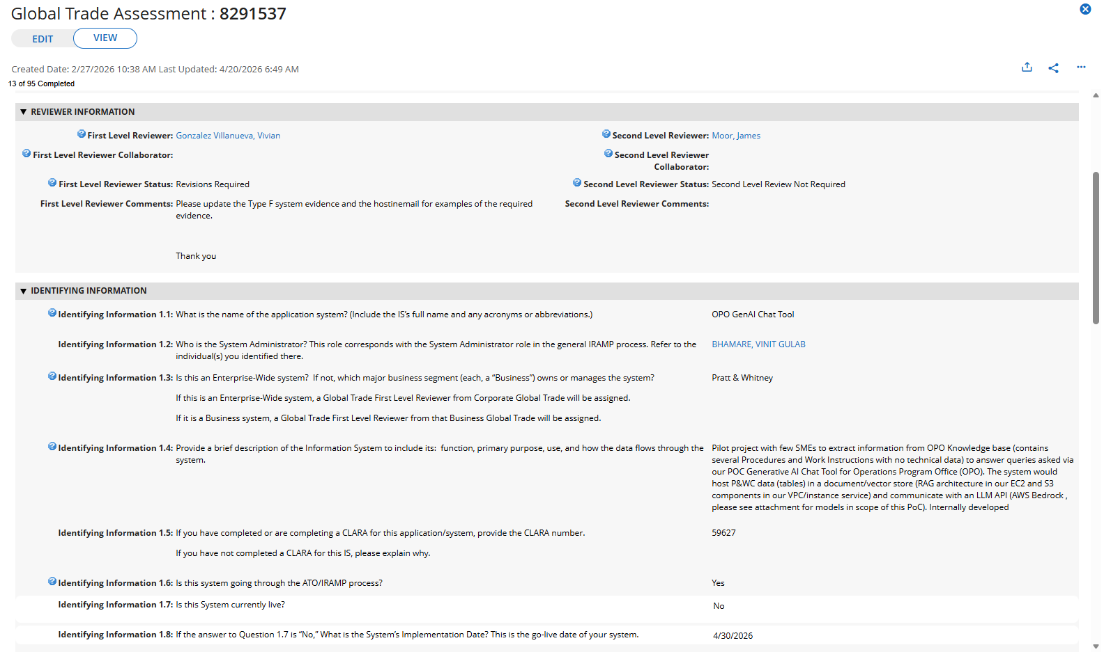
Global Trade Assessment - 8291537​

Slide 27
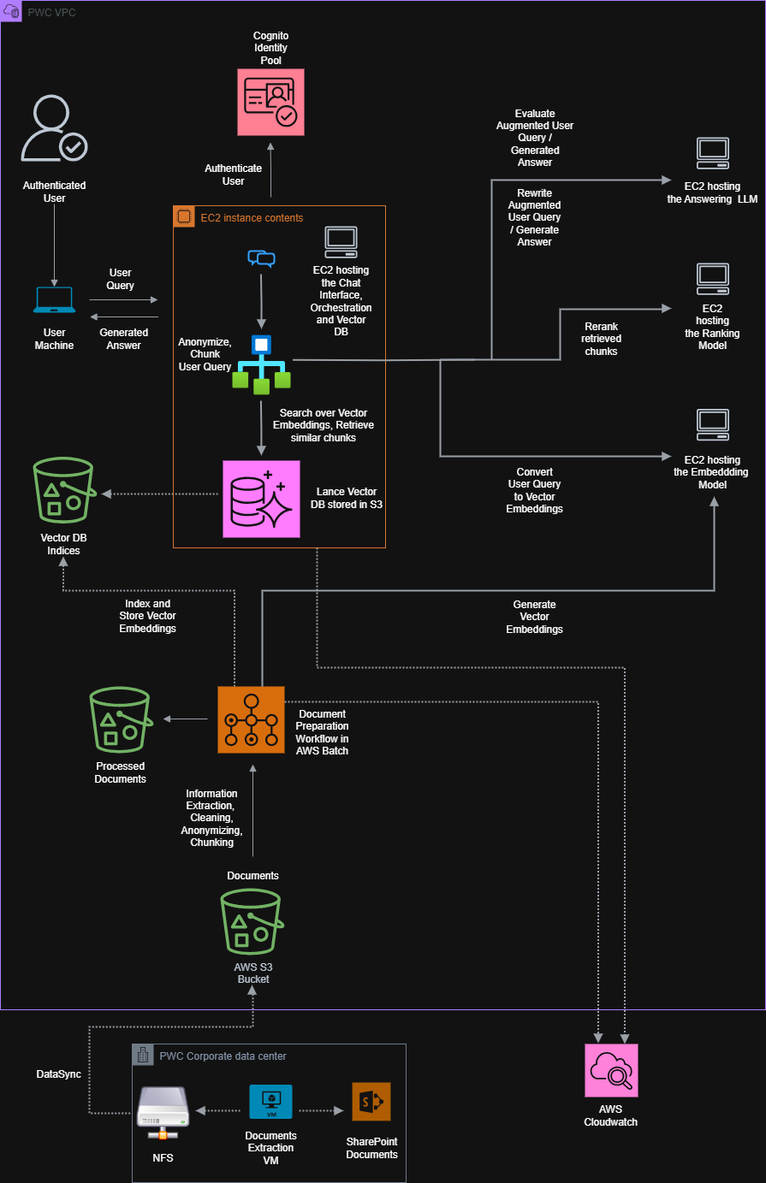
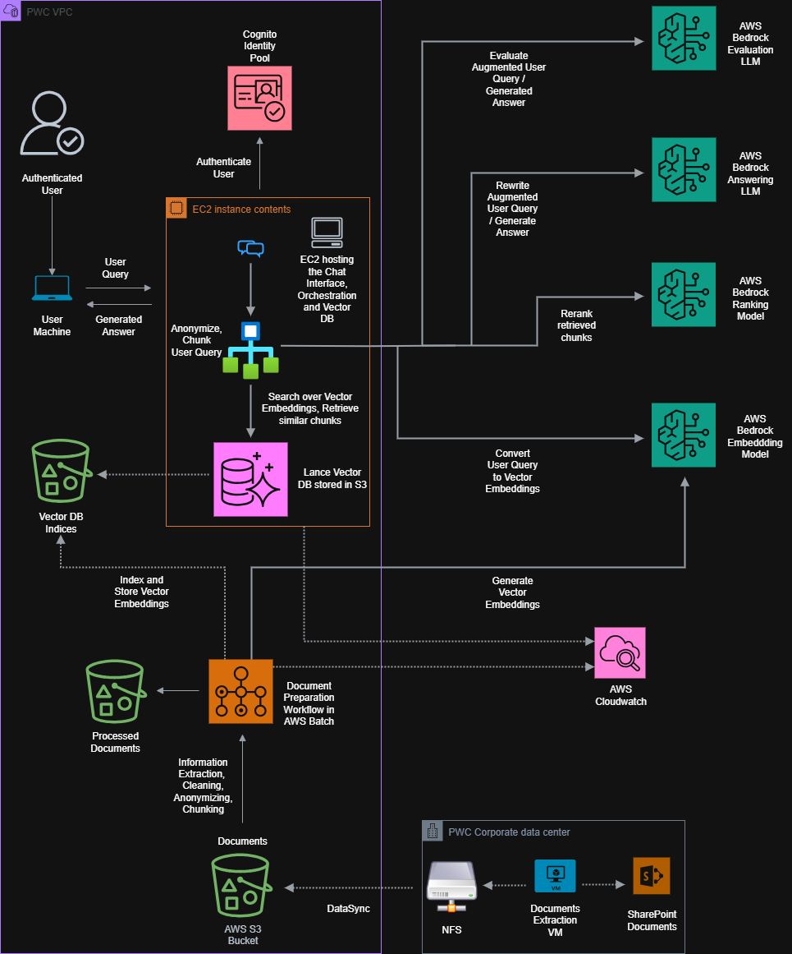
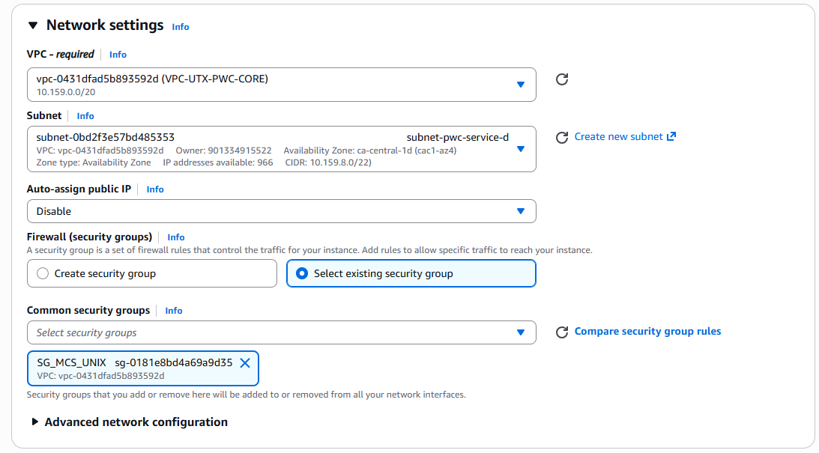
Current Hurdles / Next Steps
GT Assessment
Proof of Hosting evidence. (Currently using a temporary solution from Raymundo Garcia & Saketh, adopting the XRM Chat Tool infra)
We will have to update the evidence on the GTA once the system has been set in place.
Need dedicated assistance form someone from the DT Infra Team.

Slide 28
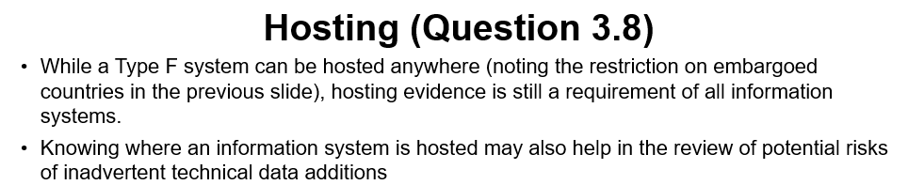
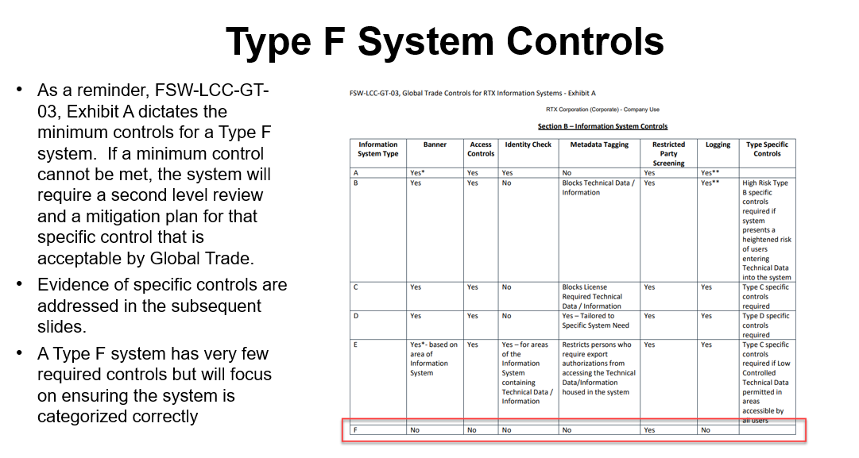
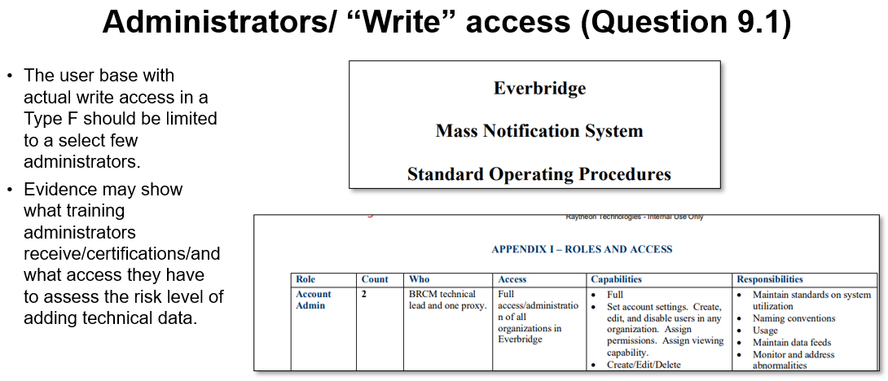
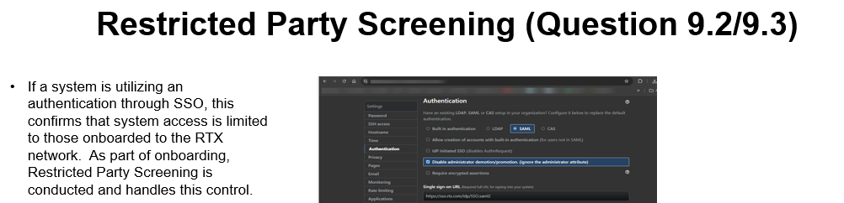
Current Hurdles / Next Steps
GT Assessment
Type F System Reference proof

Slide 29
Action Items
Code Documentation in Confluence
ADO setup for the code repository – Clement, Raymundo
Data Scientist / MLE to review the code – Nada’s Team
Business Plan slides with financial impact (Vinit)
Document the process so far with DT
Each step done with timeline (checklist fashion)

